Slide 1


ORDER AND INVOICE MANAGEMENT SYSTEM
IGATE is now a part of Capgemini
Notes:
Copyright © 2011 IGATE Corporation (a part of Capegemini Group). All rights reserved.
No part of this publication shall be reproduced in any way, including but not limited to photocopy, photographic, magnetic, or other record, without the prior written permission of IGATE Corporation (a part of Capegemini Group).
IGATE Corporation (a part of Capegemini Group) considers information included in this document to be confidential and proprietary.

Slide 2

Team Members
1.Mohammed Shadab Siddiqui
2.Manish Baranwal
3.Monika Nayak
4.Mugdha Mulay
5.Nidhi Agrawal (lead)

Slide 3
Project Details
Objective
Development of an Order and Invoice Management System (OIMS)
Abstract of the project
This project is aimed at developing an Order and Invoice Management System (OIMS).
Acme inc. is organization which manufactures stationary items like books, pen, printing paper, etc. They receive order from all over the country for their stationary product. Initially they are managing all the activities like inventory management and order management manually. They want an online application which will allow the internal employee of the organization to maintain product and customer record as well as maintain the details of the order place and creating invoices for the same.

Slide 4
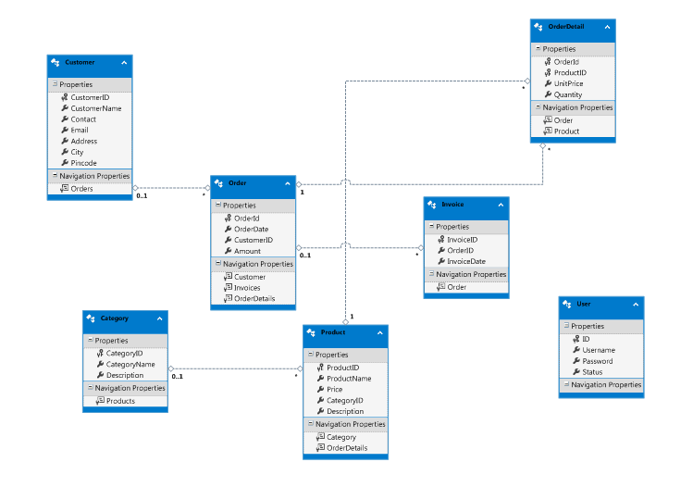
Diagram Depicting Entire Project

Slide 5
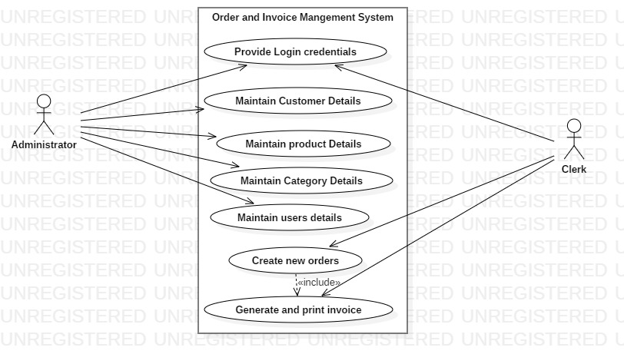
Use Case Diagram

Slide 6
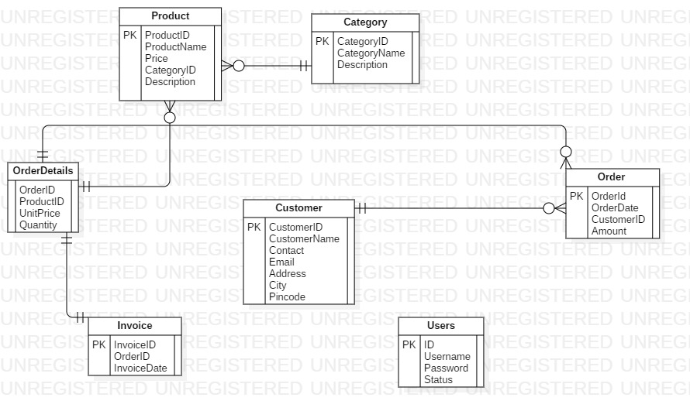
Class Diagram

Slide 7
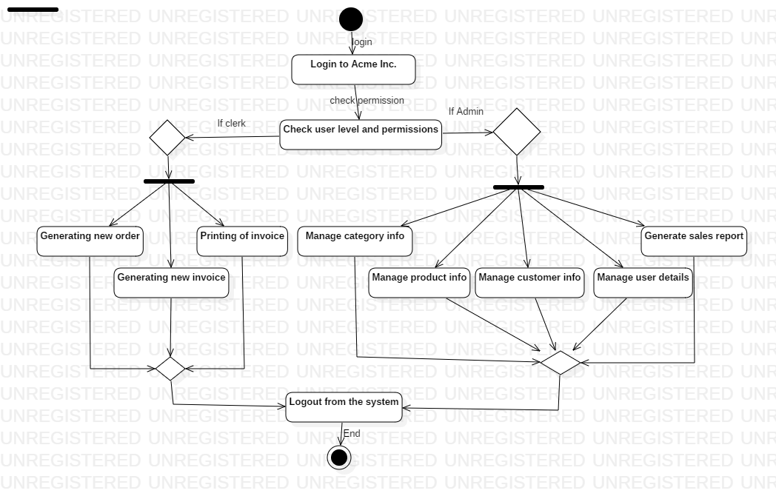
Activity Diagram

Slide 8
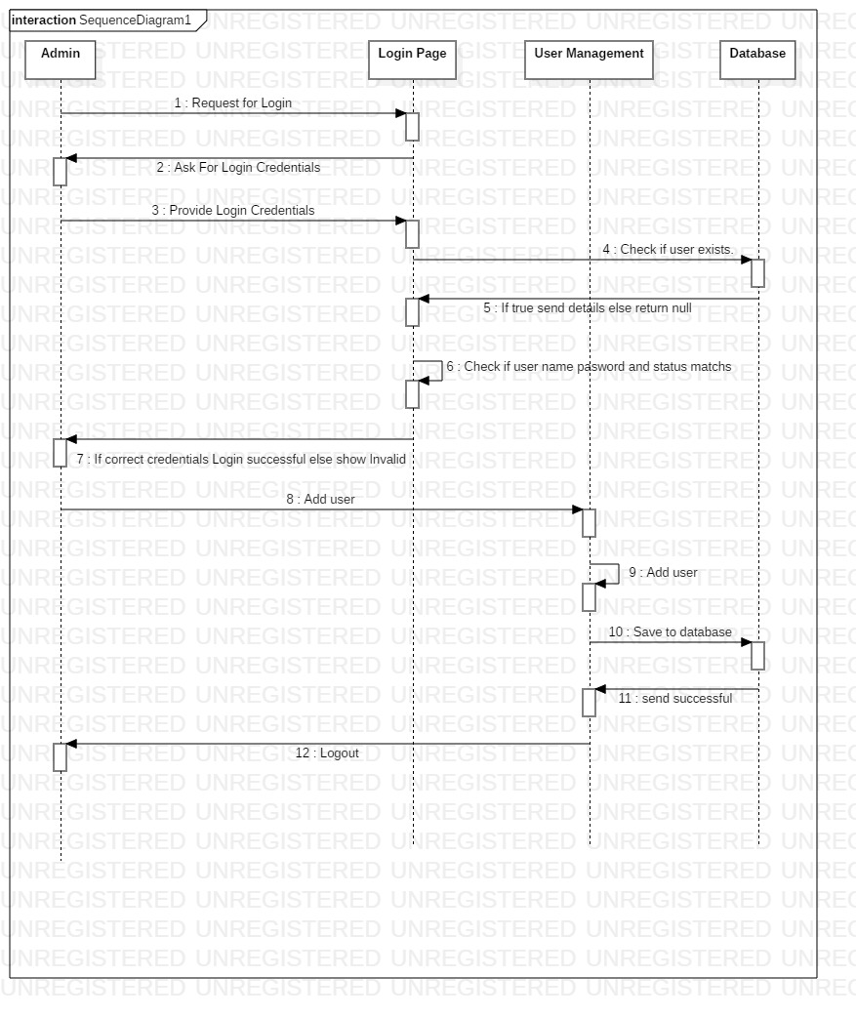
Sequence Diagram

Slide 9
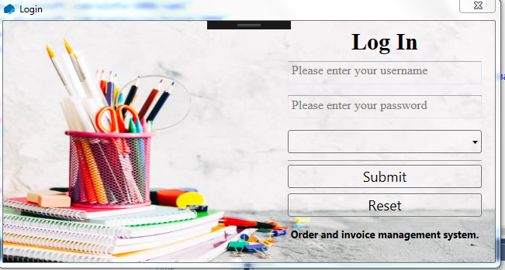
LogIn Page

Slide 10
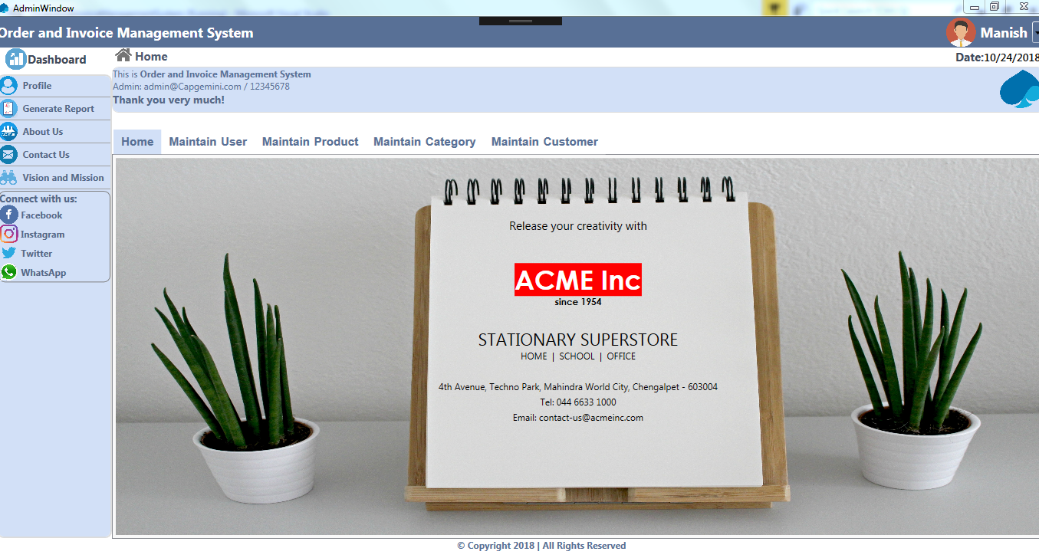
Admin Window

Slide 11

Clerk Window

Slide 12
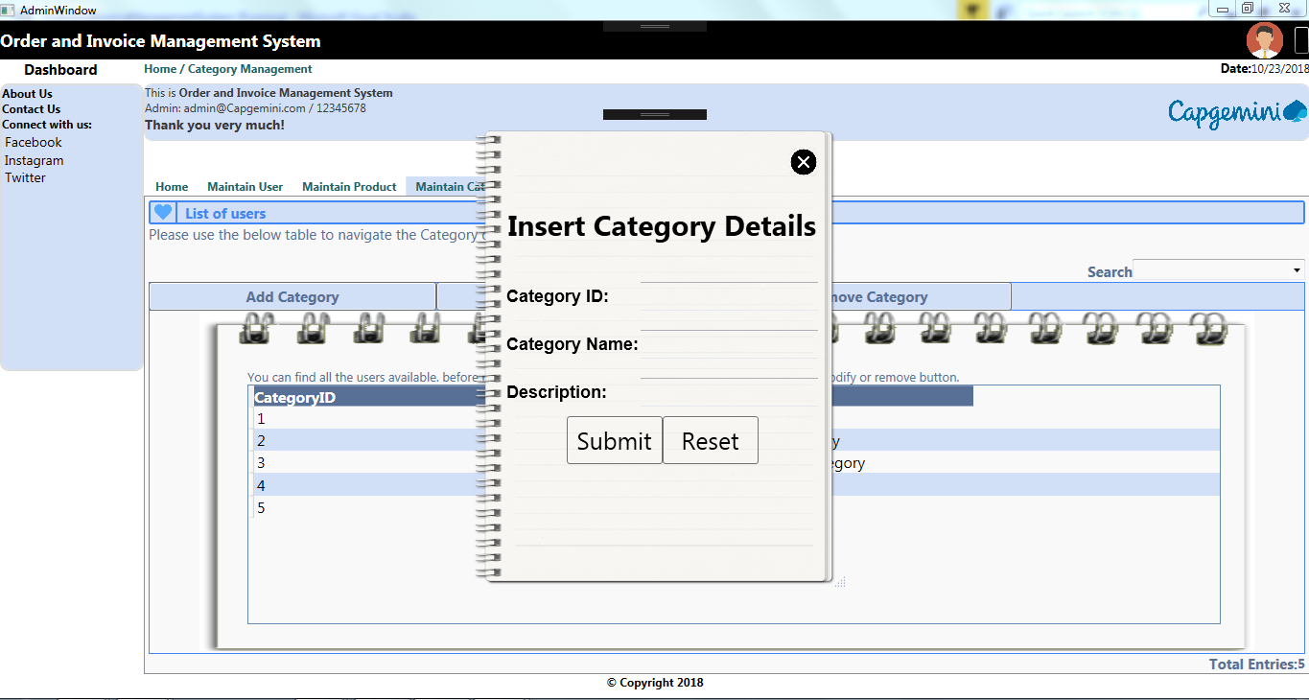
Insert

Slide 13
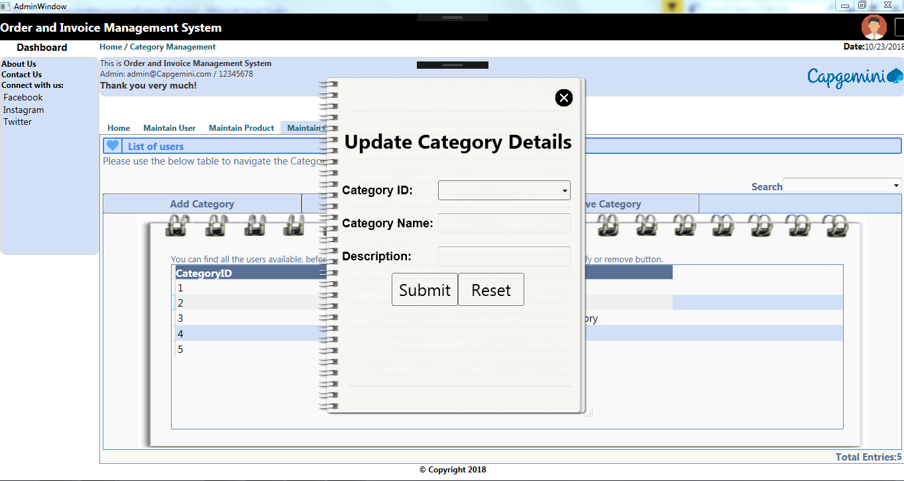
Update

Slide 14
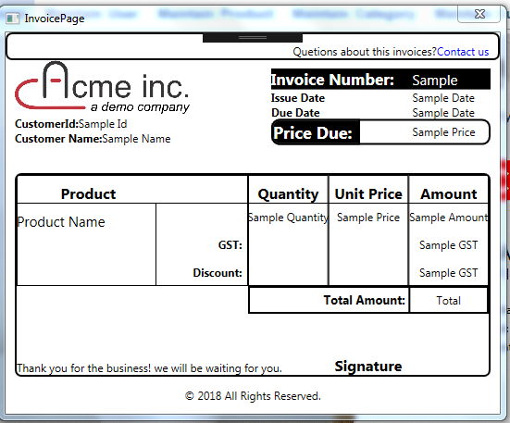
Generate Invoice

Slide 15
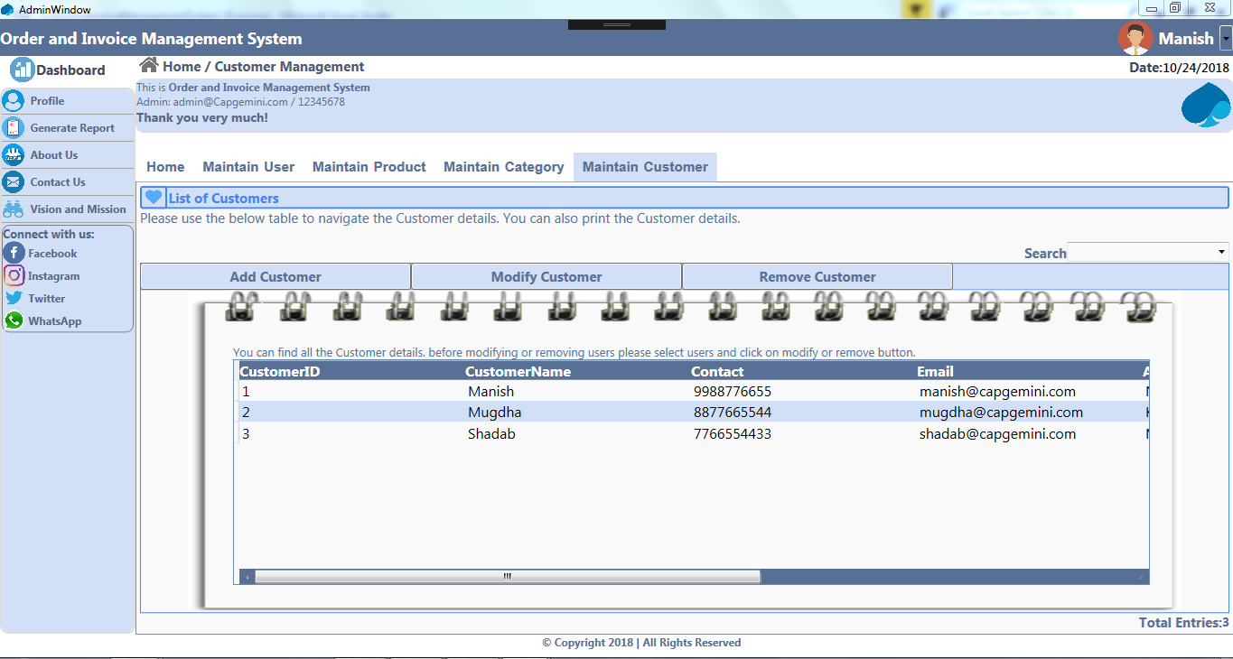
Admin Window

Slide 16
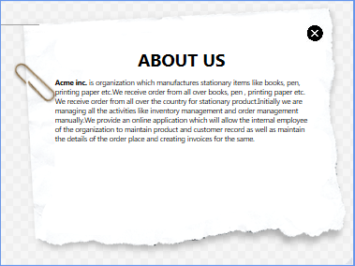
About Us

Slide 17
Future Enhancements
The invoice will be able to tap into more services such as order management where customers can modify their plans and discontinue services right from the invoice.
Improving UI to make it more user friendly
Provide chat service to enable admins to communicate with users.
Using barcode scanner to scan products.

Slide 18

Thanks

